Slide 1
Tiny Invaders: New Threats from Cables We Take for Granted

Slide 2
We Will Talk About
The Good – A System On A Chip embedded In A Cable
(Protecting against) The Bad Chip embedded in a Cable
The Ugly – What an attacker can do
Encrypt Everything
Rolling Your Own Encryption
Captain Janeway’s Encryption
Closing

Slide 3
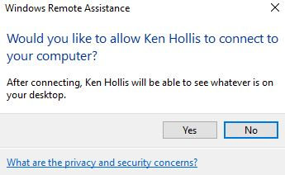
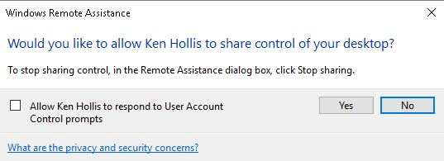
We are ALL Tech Support …
Tech Support Phone call …
Click the “Get Help” Icon …
Click “Send”
Click “Yes” to allow me …
Click the box and “Yes”
NOOO … NOOO !!!!!!!
Notes:
My inspiration for this cable … Phone Call with parents to connect to their computer
Microsoft Windows 10 get help from friend
VNC
Chrome Remote
Go To Meeting
Etc …
… But installing software on a computer to allow remote access can allow attackers to remotely access the computer also if the intermediary site is somehow compromised!!! ???

Slide 4
There must be a better way
Proposed is a simple cable that can be connected inline
Chip is embedded into the USB cable or a Network Cable
Power Budgets
PoE 13 watts to PoE+ 25.5 Watts)
USB (0.5W to 100W) … Depending on the port
System on a Chip (SoC) can meet the above requirements
Chip can be small enough to fit inside cable
Example : Intel Atom ® 3338 chip – 8.5 Watts, 4x2.5 GBE interfaces
Add some NVRAM to the flexible circuit and you have a computer
Notes:
1) Overview
Chip is embedded into the cable – Ethernet or USB
Power Budgets – PoE (13 watts to 25.5 Watts), USB (0.5W to 100W)
Heat Dissipation via the shielded wire, chips mounted on flexible circuits wrapped around the wire or inside the connectors
Apple Lightning → USB https://en.wikipedia.org/wiki/Lightning_(connector)
USB-C already has an embedded chip – What is on that chip? https://en.wikipedia.org/wiki/USB-C#Cables “They are electronically marked cables that contain a chip with an ID function based on the configuration channel and vendor-defined messages (VDM) from the USB Power Delivery 2.0 specification.”
Low power USB devices – 0.5 W up to high power – 100W - https://en.wikipedia.org/wiki/USB#Low-power_and_high-power_devices
As with all specs it is … complicated - https://en.wikipedia.org/wiki/USB_(Physical)#Power_Delivery_(PD) – Speaks about power allowance / requests
Different SoC's and their power requirements - https://en.wikipedia.org/wiki/System_on_a_chip
Die size - https://en.wikipedia.org/wiki/List_of_Intel_Atom_microprocessors - Diamondville 45 nm - Die size: 25.96 mm² (3.27mm×7.94mm, 0.128“x0.314“)
Intel is now at a 10nm size as of 2017, you can do the math on how the above die size has shrunk - http://fpga.org/2017/03/29/intel-10nm-the-wind-in-our-sails/
Intel specs from Intel Website / PDF - https://www.intel.com/content/www/us/en/processors/atom/atom-c3000-family-brief.html

Slide 5
The Cable
For the USB Cable that has an embedded chip connected between the docking station and the computer:
Remote KVM
Connect ad hoc
Passwords still required to log into the local computer
Remotely reinstall the OS or firmware
Log the URLs that were visited
Notes:
2) The Good USB (cable) that connects the computer to the docking station:
Can be used as a remote KVM – The tech support we ALL do – Mom and Dad
Allows the remote access to get into BIOS / Complex operations (if the docking stations gets DHCP and it powers the USB). Essentially an OOB / Poor mans iLO
Always on, no software to install assuming the computer is turned on
Passwords are needed to get into the locked system, same as at the keyboard. Brute forcing would be painful assuming a good password is chosen
Log URLs - "What did you install?" – "I didn't install anything" (check the logs)

Slide 6
Protecting Against The Bad
The cable can help provide security
Depending on how much CPU and NVRAM / RAM is available on the SoC
“Personal”
IPS/IDS
Firewall
Hash lookup for malicious software, I.e. use Virus Total
Protect against memory resident malicious software
Log IP addresses / websites and send back to corporate logger
Above protections are not accessible by OS / user / attacker
Protecting cables from attack / data going across the wire
Notes:
3) (Protecting against) The Bad
→ How much of the below depends on how much CPU and NVRAM is available to the cable
IPS / IDS
Firewall
Offsite Worker protection (I.e. send new firewall or IPS rules to chip / cable that you sent home with the user outside of the corporate environment), cheapter than a full scale IDP/IPS per employee
Rules / monitoring cannot be changed by malicious software on the host machine, controlled by you, the administrator
Check incoming executables before passing to the local computer, hold until compare with VirusTotal is complete and pass along if not malicious
Not controlled by the user / onboard software so cannot be deleted from the system
Logging of IP's / websites visited
Military grade hardening of cables:
Pressurized Ethernet Cable Runs
Point to Point encryption devices

Slide 7
Hunting The Bad
Monitor your egress traffic and DNS requests
Do you “trust” your suppliers?
Keep your user's paranoid about security? Picking up random devices?
As long as there are users, we (computer security professionals) will have a job
Do you have a camera in your public meeting room(s) to monitor untrusted outsiders?
Notes:
3) (Continued)
Monitoring the data ingressing and exiting your network is more important than ever, are you positive that someone hasn't plugged a rogue Wireless or wired ethernet tap into your network already?
Do you passively monitor your users DNS requests for "strange" websites?
E.g. https://azure.microsoft.com/en-us/blog/heuristic-dns-detections-in-azure-security-center/
https://www.helpnetsecurity.com/2013/05/28/dns-anomaly-detection-defend-against-sophisticated-malware/
Be aware of supply chain attacks:
Cables left in public places or mailed to you
Do you know if your supplier is giving you 1 in 50 cables with a chip? If you have a large project with 10,000 cables 1:50 cables might get one installed in a PoE switch
What about Transceivers that you put into your networking equipment? They could also be compromised
Do you have a meeting room or a lobby outside of your locked doors at your company that are not monitored?
Somewhere an attacker could drop off a compromised cable? Attach an ethernet tap / Raspberry Pi into your network surreptitiously?

Slide 8
As an aside …
Bloomberg speaking about supply chain attacks
(I am skeptical)
MAYBE in 5 years ????
BUT … What other devices can contain these chips?
“Paranoia is just reality on a finer scale” - 1995 film Strange Days
Notes:
The original Bloomberg Story:
https://www.bloomberg.com/news/features/2018-10-04/the-big-hack-how-china-used-a-tiny-chip-to-infiltrate-america-s-top-companies
An implanted chip in a server is possible, but the size of a pencil tip? I am skeptical that the technology is that small … But …
An example of how this attack might work:
https://www.electronicdesign.com/embedded-revolution/how-hack-server-motherboard
USB Key Logger hidden in a cable “Bad USB”:
http://mg.lol/blog/badusb-cables/
Chips can be hidden in Docking Stations, USB Hubs, anything connected to your computer

Slide 9
The Ugly
Using the cable for badness
Compromise of USB cable for docking station == access to everything
What firmware is available that the attackers could use to concrete their presence?
BSides Seattle February 3rd, 2018
Platform Firmware for Blue Teams: Detecting Evil Maid Attacks
Lee Fisher CTO, PreOS Security
Obvious logging – Keyboard, video screenshots, files on attached storage
Are there Bluetooth USB adapters on your docking station that could be used by the attacker to get to nearby Bluetooth devices? Like your Car?
Notes:
4) The Ugly
Obviously, a tool that is used for good can also be subverted to be used for the bad
Ethernet – The attacker can track anything on the wire FOR THAT ONE USER, clear text passwords anybody?
USB – If the USB is between the laptop and docking station the attacker owns everything that is on that USB bus → Keyboard, Video, Attached storage, Attached DVD drives, Network adapters, Blue tooth keyboard, Etc …
Exploit of video from HDMI connected port – There is a small computer in your monitor:
https://twitter.com/xipitersec/status/764188263858876416
Access to firmware of any connected USB devices
https://firmwaresecurity.com/tag/bsidesseattle/
https://firmwaresecurity.files.wordpress.com/2018/02/bsidesseattle2018-fisher-defending-firmware.pdf
KVM control
Keyboard Logging

Slide 10
Really Ugly
The attacker is now inside your network
They can go as low and slow as they want, they have persistence
How hardened is your infrastructure?
Do you have a “Red Team” or security minded coworkers to help identify risks / vulnerabilities?
Red Team / Pen Testers are NOT the enemy – Learn all you can from them
Attackers can change code that is on the wire
… Or look for your code repositories and change code there
Notes:
4) … (Continued)
Standard stages of attacks with an “extra” one:
Phase 1: Reconnaissance
Phase 2: Initial compromise
Phase 3: Command & control
Phase 3.1: After the cable is installed MORE Reconnaissance to see what internal resources can be accessed
Phase 4: Lateral movement
Phase 5: Target attainment
Phase 6: Exfiltration, corruption, and disruption
The attacker now has access internally to your network / devices on your network
Are you “Hard and Crunchy” on the outside but “soft and chewy” on the inside?
Attacker can go low and slow, look for the user to access open SMB shares and look for secrets on those network shares
You don’t have ANY open shares on your network, correct?
Your users don’t open personal / computer shares to each other, correct?
Do you have / have you hired a Red Team?:
https://www.tripwire.com/state-of-security/risk-based-security-for-executives/connecting-security-to-the-business/red-team-v-blue-team-they-are-in-fact-one-the-purple-team/
Change code (either ingress or egress) as it passes over the wire, intercept, hold the file till complete and make changes to insert attack software:
Incoming .exe files
Incoming .zip or .rar files that have executables inside, change those
Incoming .sh or .ps1 files or any kind of scripts
Now the attacker is on the machine through one of the pieces of software that was downloaded
Look for code repositories and add “extra” code into your repository

Slide 11
Encrypt
Encrypt everything. Assume Breach.
Call to arms:
Encrypt USB Keyboard data
Encrypt PC to Video Data
Encrypt USB drive data
USB link data / protocol
Encrypt ALL network traffic that you can
Encrypt <everything> …
… You are thinking “Easy to say … But implementing not so much …”
True
Notes:
What part of “Encrypt Everything” is not clear?:
https://www.beencrypted.com/ultimate-encryption-guide/
USB Link Protocol - http://www.techdesignforums.com/practice/technique/usb-3-0-link-layer/
Design and Verification of USB 3.0 Link Layer (LTSSM) - https://pdfs.semanticscholar.org/a4bf/64df084659820daedaf02f47fb5ae2bf411f.pdf
The attacker can have access to ANYTHING connected to your USB hub. You must assume that there is a man-in-the-middle already
This is NOT an easy task. Everybody who develops software and firmware will have to work on this problem “In their free time” …

Slide 12
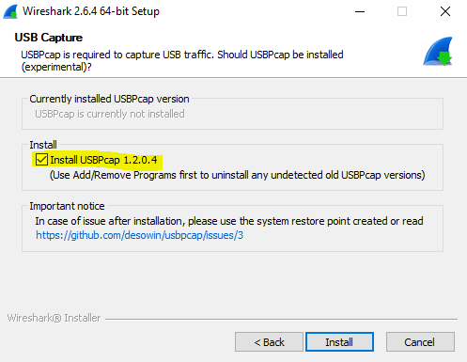
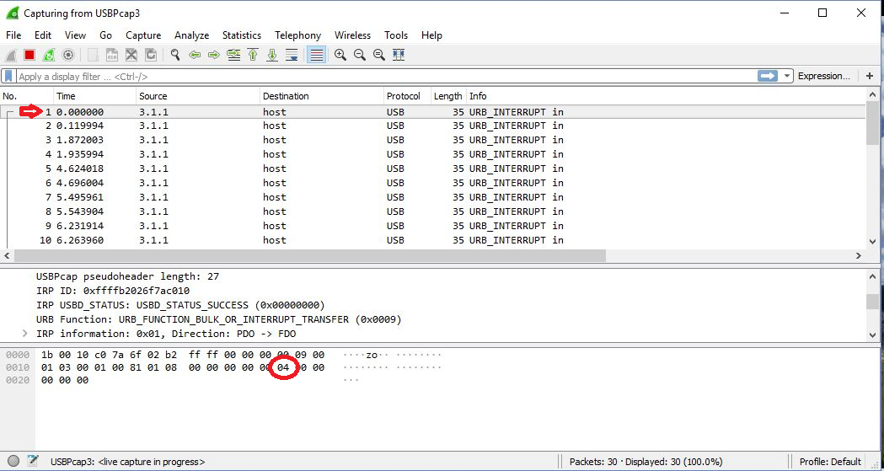
Dump the traffic on your USB
You can dump your USB traffic easily using Wireshark
And you can see per the dump and
the USB HID usage table that
I typed an “a”
Notes:
If you are interested in seeing what data goes across the USB bus you can dump using Wireshark
USB HID table:
http://www.freebsddiary.org/APC/usb_hid_usages.php

Slide 13
Rolling your own encryption
Steps for creating your own encryption protocol

Slide 14
Rolling your own encryption
Rule #1:
Don’t

Slide 15
Rolling your own encryption
Rule #2:
Seriously … Don’t.
Use an encryption method that has been
vetted by the encryption experts …
Know the “limits (how secure) the method you choose is even if vetted by experts
Notes:
Limits of how long an encryption key is good for. Example the DES standard:
In DES 56-bit key 1970 considered “Secure”.
Per https://en.wikipedia.org/wiki/Data_Encryption_Standard :
“the Electronic Frontier Foundation's DES cracker in 1998 that demonstrated that DES could be attacked very practically, and highlighted the need for a replacement algorithm”
MD5:
https://en.wikipedia.org/wiki/MD5
‘MD5 was designed by Ronald Rivest in 1991 to replace an earlier hash function MD4,[4] and was specified in 1992 as RFC 1321.’
‘As of 2010, the CMU Software Engineering Institute considers MD5 "cryptographically broken and unsuitable for further use",‘
Know the limits of your technology, allow for that technology to be upgraded easily in your code, put the encryption code in its own routine.

Slide 16
Rolling your own encryption
Rule #3:
Assuming you ignore Rule #1 and #2 for your
own reasons, get your “Super Dooper algorithm”
vetted by an expert who will tell you all the holes
Notes:
The below method, which is more obfuscation than encryption, was looked at by an expert. They very kindly told me that the method was less than comprehensive and not difficult to break.

Slide 17
… And I rolled my own
For a different project implemented a simple peer-to-peer text chat, encrypted
Devised own encryption as opposed to implementing something like ECC:
https://en.wikipedia.org/wiki/Elliptic-curve_cryptography
Notes:
Yeah … Right. I just wanted a simple algorithm

Slide 18
Captain Janeway's Encryption
Simple to implement, just one function → The Random Number generator:
Random_number = new Random(seed)
Random_number = Random_number.Next(x, y)
Choose the seed, MUST be same seed for both peers
Since this is a Pseudo Random Number Generator you keep BOTH Client and Server PNRG’s in sync and it MUST be the SAME PNRG algorithm
Choose length of character string for this encrypted character
Choose position to put your character based on number from “Step 3.”
Generate random characters for all other positions
Repeat steps 3 through 5 for each character you want to send
Append these strings into one string and then send
… Example is on the next page …
Notes:
Captain Janeway's Encryption description
PNRG’s are exactly as described, they *LOOK* like random number generators but when you put start with the same seed, they give out the same number for the .Next function
A crypto professional looked and very gently gave me excellent feedback. The issue is with this obfuscation is that if the attacker has your code (and they will if it is in the firmware), the algorithm just like the “Enigma” machine. The obfuscation can be broken by trying all the combinations for the seed:
https://en.wikipedia.org/wiki/Cryptanalysis_of_the_Enigma
This is why I don’t do electrical installations except the simplest ones at my own house ☺ …

Slide 19
Capt. J’s Encryption example
String to encrypt and send is “Hello World” (original, I know), max random length of 50:
Charter position = “i”, Rand1 = “Number of Random Characters”, Rand2 = “Position of ‘encrypted’ charter in Rand 1 string”, String = string generated
String to send = “Hello World” (length = 11 characters, Characters 0 through 10)
i=0, Rand1 32, Rand2 20, String pnXI).K7 o|koL7XP{2HKcGRYe>-qw;;
i=1, Rand1 12, Rand2 5, String pnXI).K7 o|koL7XP{2HKcGRYe>-qw;;>Wnke{yT%"72
i=2, Rand1 49, Rand2 40, String pnXI).K7 o|koL7XP{2HKcGRYe>-qw;;>Wnke{yT%"72a'1n76D/uH;|bh X=uSeEPrGjS!\F`/@Zw[%_)#l$p6G.Rl90
i=3, Rand1 28, Rand2 13, String pnXI).K7 o|koL7XP{2HKcGRYe>-qw;;>Wnke{yT%"72a'1n76D/uH;|bh X=uSeEPrGjS!\F`/@Zw[%_)#l$p6G.Rl90b?\7G03h#b5elf49xBh,xw4rOs/)
i=4, Rand1 36, Rand2 32, String pnXI).K7 o|koL7XP{2HKcGRYe>-qw;;>Wnke{yT%"72a'1n76D/uH;|bh X=uSeEPrGjS!\F`/@Zw[%_)#l$p6G.Rl90b?\7G03h#b5elf49xBh,xw4rOs/){9n(z{mbCPKpu%>m*M2sWJN#YQNK,A7o'Ls&
i=5, Rand1 22, Rand2 9, String pnXI).K7 o|koL7XP{2HKcGRYe>-qw;;>Wnke{yT%"72a'1n76D/uH;|bh X=uSeEPrGjS!\F`/@Zw[%_)#l$p6G.Rl90b?\7G03h#b5elf49xBh,xw4rOs/){9n(z{mbCPKpu%>m*M2sWJN#YQNK,A7o'Ls&]j7I6|8_ '!/S`h_to;Pik
i=6, Rand1 24, Rand2 11, String pnXI).K7 o|koL7XP{2HKcGRYe>-qw;;>Wnke{yT%"72a'1n76D/uH;|bh X=uSeEPrGjS!\F`/@Zw[%_)#l$p6G.Rl90b?\7G03h#b5elf49xBh,xw4rOs/){9n(z{mbCPKpu%>m*M2sWJN#YQNK,A7o'Ls&]j7I6|8_ '!/S`h_to;PikMBV"8CD"}tWHK`yIAL6BQO>v
i=7, Rand1 22, Rand2 13, String pnXI).K7 o|koL7XP{2HKcGRYe>-qw;;>Wnke{yT%"72a'1n76D/uH;|bh X=uSeEPrGjS!\F`/@Zw[%_)#l$p6G.Rl90b?\7G03h#b5elf49xBh,xw4rOs/){9n(z{mbCPKpu%>m*M2sWJN#YQNK,A7o'Ls&]j7I6|8_ '!/S`h_to;PikMBV"8CD"}tWHK`yIAL6BQO>vV0[WS]W0Ag']oy ;a}0]7<
i=8, Rand1 49, Rand2 47, String pnXI).K7 o|koL7XP{2HKcGRYe>-qw;;>Wnke{yT%"72a'1n76D/uH;|bh X=uSeEPrGjS!\F`/@Zw[%_)#l$p6G.Rl90b?\7G03h#b5elf49xBh,xw4rOs/){9n(z{mbCPKpu%>m*M2sWJN#YQNK,A7o'Ls&]j7I6|8_ '!/S`h_to;PikMBV"8CD"}tWHK`yIAL6BQO>vV0[WS]W0Ag']oy ;a}0]7<Ex#SHyw.J,H`3fHI6o;?2AaP5&mP.81:V65]O*.4GX[QQ=r(x
i=9, Rand1 28, Rand2 21, String pnXI).K7 o|koL7XP{2HKcGRYe>-qw;;>Wnke{yT%"72a'1n76D/uH;|bh X=uSeEPrGjS!\F`/@Zw[%_)#l$p6G.Rl90b?\7G03h#b5elf49xBh,xw4rOs/){9n(z{mbCPKpu%>m*M2sWJN#YQNK,A7o'Ls&]j7I6|8_ '!/S`h_to;PikMBV"8CD"}tWHK`yIAL6BQO>vV0[WS]W0Ag']oy ;a}0]7<Ex#SHyw.J,H`3fHI6o;?2AaP5&mP.81:V65]O*.4GX[QQ=r(xFF!]f#6P=B+G}1x.)zQhlw,`'uWd
i=10, Rand1 9, Rand2 9, String pnXI).K7 o|koL7XP{2HKcGRYe>-qw;;>Wnke{yT%"72a'1n76D/uH;|bh X=uSeEPrGjS!\F`/@Zw[%_)#l$p6G.Rl90b?\7G03h#b5elf49xBh,xw4rOs/){9n(z{mbCPKpu%>m*M2sWJN#YQNK,A7o'Ls&]j7I6|8_ '!/S`h_to;PikMBV"8CD"}tWHK`yIAL6BQO>vV0[WS]W0Ag']oy ;a}0]7<Ex#SHyw.J,H`3fHI6o;?2AaP5&mP.81:V65]O*.4GX[QQ=r(xFF!]f#6P=B+G}1x.)zQhlw,`'uWdu{sxHpi9d
Notes:
This works for ASCII characters or for pure data. The “filler” characters need to be the same as the characters you are trying to obfuscate. If your obfuscated characters are all ASCII then only use filler characters that are ASCII, if all your characters is data that is 0 through 255 then use random values of 0 through 255 for your filler.
This is an ASCII example so that it is easier to show as an example.

Slide 20
Less Than Perfect Encryption
This is low CPU utilization obfuscation
Maybe you don’t need perfect encryption
Can you encrypt parts of the screen data, change the seed and encrypt more using a VERY large seed?
Can you encrypt large data transfers so that they are absolutely HUGE?
Do NOT use for very small bandwidth operations like a USB keyboard operations as these can be saved off to disk, slowly transferred out and broken offline
Notes:
The case for Less-Than-Perfect Encryption
Low CPU utilization for this method, is it secure "enough" for your purposes?
This encryption could be used in conjunction with “real” encryption to change the PRNG seed on a regular basis
I.e. spike the CPU using “real” encryption for a new PRNG seed but not constantly bogging down the CPU
More obfuscation than true encryption
Stream encryption – You can encode a handful of characters, send then, do more, send them, etc.
Block encryption– Encode a block of characters that fits in “X” characters, write to disk, possibly add in filler characters as needed to obfuscate further
The "seed" should be strong encryption via asymmetric algorithm that is somehow negotiated between the two machines performing the exchange
Do NOT Roll your own PRNG (Pseudo Random Number Generator). See previous comments about rolling your own encryption.
Needs the same EXACT PRNG on both ends of the connection
Your code in the firmware is not secret, so the algorithm can be reverse engineered
Can someone create a software Enigma machine to figure out what you are obfuscating?
Can they run software on the host computer to offload the encryption because of large amounts of bandwidth and get the goods locally for later exfiltration?
Can Quantum bit easily decode this algorithm? Is it open to Markov chain analysis?
What kind of data needs "strong" encryption rather than "just enough"?

Slide 21
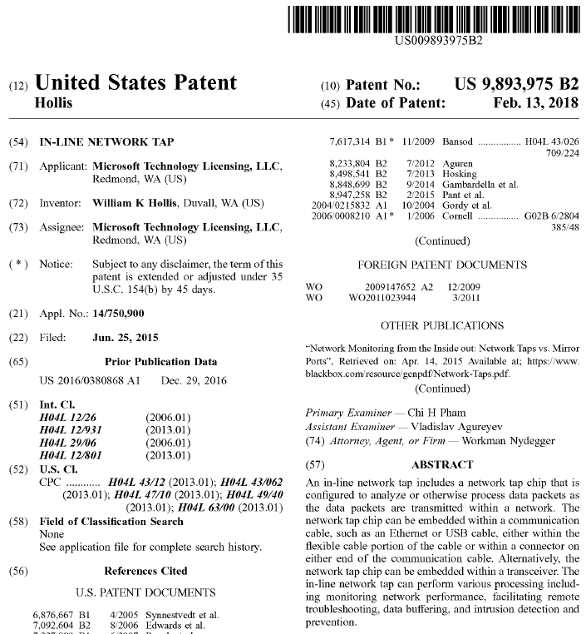
Patent US 9,893,975
If you thought that creating these cables might be a new business for you …
Note: I Am Not A Lawyer (IANAL), you will have to figure out how to work with Microsoft. Don’t ask me, I can’t help.
(… And I am SURE that Nation states wouldn’t infringe on this patent … Right? And countries that don’t have intellectual property agreements with the US would never build this, right?)
Hence why we need to encrypt everything

Slide 22
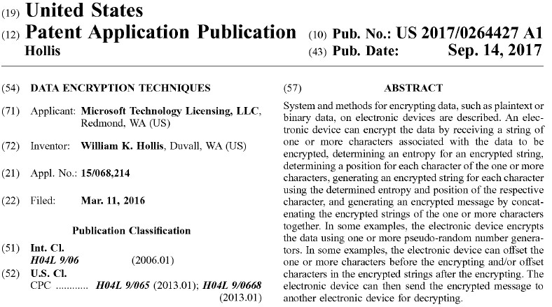
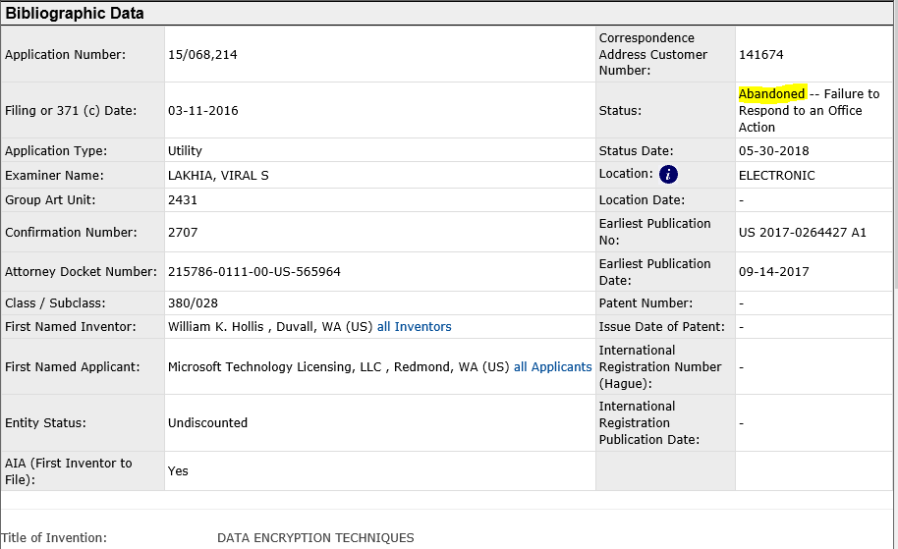
The Good Part …
But Wait … There’s More …
If you liked Captain Janeway’s encryption have at it:
ABANDONED (Again, IANAL so you should probably talk to one first)
http://www.digital.net/~gandalf/CaptJ_Enc.txt
Notes:
See the Patent Office for the above information on Application Number: 15/068,214 (Otherwise known as US 2017-0264427 A1):
http://pdfaiw.uspto.gov/.aiw?docid=20170264427
Client and server all in one program:
http://www.digital.net/~gandalf/CaptJ_Enc.txt

Slide 23
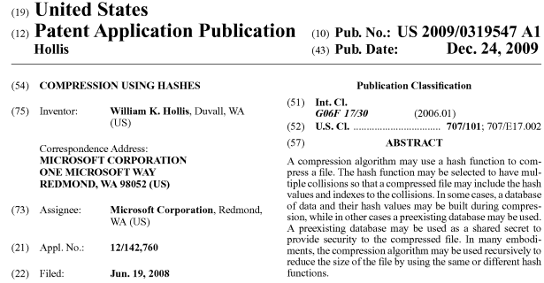
As an aside …
If you happen to have a 1028 bit quantum bit computer waiting for a project …
“COMPRESSION USING HASHES”, a proposal for recursive compression:
http://pdfaiw.uspto.gov/.aiw?docid=20090319547
Notes:
I don’t have a Quantum bit computer, so I cannot test out the implementation, but I would appreciate it if someone would:
http://pdfaiw.uspto.gov/.aiw?docid=20090319547
Likewise abandoned … Application Number: 12/142,760

Slide 24
For a copy of these slides (and all my notes and links) See my OneDrive:
https://1drv.ms/f/s!AsoLDJx_szsuc_zSFFU0B1gKkFc
Folder:
BSides_Portland/BSidesPDX_Tiny_Invaders_Final.pptx
BSides_Portland/BSidesPDX_Tiny_Invaders_Final.pdf

